Slide 1
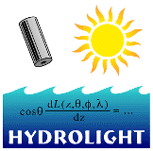
Overview of HydroLight-EcoLight
Curtis Mobley
Vice President for Science and Senior Scientist
Sequoia Scientific, Inc.
Belleue, WA 98005
curtis.mobley@sequoiasci.com
IOCCG Course
Villefranche-sur-Mer, France
July 2014
Copyright © 2014 by Curtis D. Mobley

Slide 2
Hydrolight overview
What is HydroLight?
Physical model
Computational model
Use as a tool
Software Package
Then do some runs….
Install the code on your laptops

Slide 3
Solving the RTE
A unique solution of the RTE requires:
Radiance incident onto sea
surface is known
Region of
interest:
IOPs are
known
Stretch out the
region to make
a horizontally
homogeneous
ocean
IOPs are known as a
function of depth
Bottom (can be at )
Radiance incident onto all
boundaries from outside
the region is known
A 3-D problem
A 1-D problem

Slide 4
The Radiative Transfer
Equation (RTE)
~
Given the IOPs a(z,), b(z,), and (z,,,,); the internal sources S(z,,,); and boundary conditions at the air-water surface and the bottom, HydroLight solves for the radiance distribution L(z,,,).

Slide 5
The Radiative Transfer
Equation (RTE)
NOTE: The RTE has the TOTAL absorption and VSF. Only oceanographers (not photons) care how much of the total absorption and scattering is due to water, phytoplankton, CDOM, minerals, etc.

Slide 6
Physical model
time independent
one spatial dimension (depth)
- no restrictions on depth dependence of IOPs (not a “layered” model)
no restriction on wavelength dependence from 300 to 1000 nm
arbitrary sky radiance onto sea surface
Cox-Munk air-water surface (parameterizes gravity & capillary
waves via the wind speed)
various bottom boundary options
includes all orders of multiple scattering
includes Raman scatter by water
includes fluorescence by chlorophyll and CDOM
includes internal sources (bioluminescing layers)
polarization not included (the biggest inaccuracy in HydroLight)
whitecaps not included

Slide 7
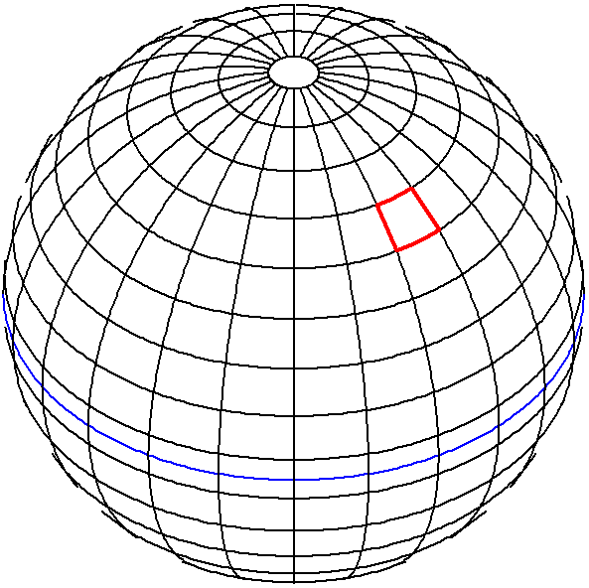
Computational model
Discretization: Average the RTE over directional “windows” (solid angle “quads”) Ω_{uv} and over wavelength bands Δλ_{j}, and save output at a finite number of depths z_{k}
HydroLight computes the directionally averaged radiance within each quad, averaged over the wavelengths within each band. Note: the outputs are still spectral quantities, not quad- or band-integrated values.
θ
y
x
z
Note: All numerical models must discretize continuous functions of depth, direction and wavelength to get a finite number of quantities to be computed.

Slide 8
Computational advantages
Run time linearly proportional to optical depth
▫ Monte Carlo ∝ exp(optical depth)
Run time independent of IOP(z) profile; arbitrary depth resolution
▫ Discrete ordinates ∝ number of homogeneous layers
Solution is “exact”
▫ all orders of multiple scattering, etc
User can/must specify all input
▫ but defaults & examples are built in for everything
Graphical user interface for input
▫ not necessary, but makes it easy to define your input
Simple analysis of output with printout, Excel, or IDL plots
▫ So you can do even less thinking about your results

Slide 9
Using Hydrolight
A research tool:
Study the connections between the various inputs and outputs of marine light fields in a controlled environment.
An analysis tool:
Characterize the ambient light field for interpretation of empirical data.
A prediction tool:
Predict the optical environment associated with a predicted set of biological and geological parameters.
A teaching tool:
Bring radiative transfer theory to the classroom without needing to know advanced mathematics.

Slide 10
From the Users’ Guide
…the HydroLight model per se is a radiative transfer model, not a model of oceanic optical properties. You, the user, must supply the inherent optical properties and boundary conditions to the HydroLight core code.
HydroLight does not know the inherent optical properties, or the chlorophyll profile, or the depth, or anything else about the water body you are interested in. You must provide this information to HydroLight. The various IOP models, phase functions, chlorophyll data sets, ac-9 data sets, etc. that come with HydroLight are examples of how to provide IOP and other information to HydroLight. You will need to replace these example routines and data sets with your own, in order to simulate the water body of interest to you.
It is not idiot proof. Garbage in, garbage out.

Slide 11
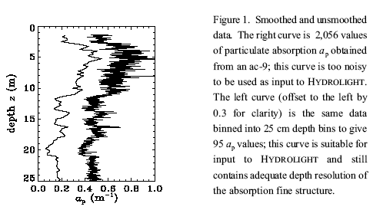
Suitable Input
clean up your data before giving it to H

Slide 12
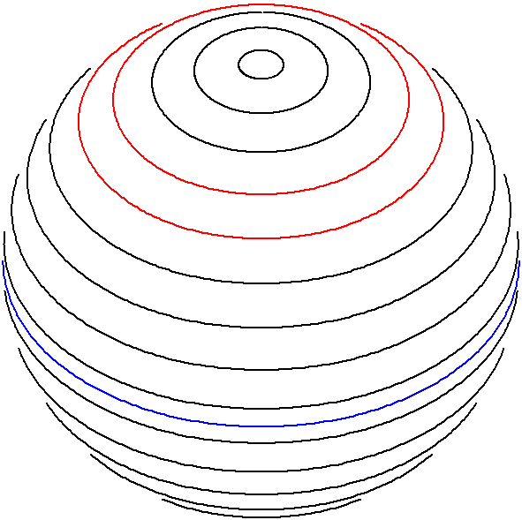
ecolight Computational model
Discretization: Average the RTE over azimuthal angle  and over polar angle “bands” (solid angles) Ω_{u} and over wavelength bands Δλ_{j}, and save output at a finite number of depths z_{k}
EcoLight computes the azimuthally averaged radiance within each solid angle band.
The irradiances and polar cap radiances are the same for H & E.
θ
y
x
z
HydroLight quads
EcoLight bands

Slide 13
HydroLight vs ecolight
Run time  fixed overhead + number of quads or bands squared, so for N = 20  bands and M = 24  bands (10 deg x 15 deg angular resolution):
HL run time  FO + (NM)² = FO + (20*24)²
EL run time  FO + (N)² = (20)²
EL/HL = [FO + (20)²]/[FO + (20*24)²] ~ 1/100 so EL ~100 times faster (can be ~20 to 1000 times faster, depending on the problem and whether other speed optimizations are used)
The inputs to H & E are identical, and the computed irradiances, diffuse attenuation coefs, reflectances, etc. are almost identical (<1% difference due to numerical algorithms). Only H can output the directional structure of the radiance distribution.

Slide 14
Software package
Graphical User
Interface for
Windows 98/.../8®
User’s input data
and models, or use
defaults
A complete software package
solves the RTE
Quick-look
printout of
selected
output
Spreadsheet
analysis of
selected output
with Excel®
Graphical
or digital
analysis of
all output

Slide 15
The Rules of the Game
I have received no funding for the development and continued improvement of HydroLight. Just as with instruments, it must pay its own way as a commercial product. HydroLight is a commercial product of Sequoia Scientific, Inc. and is copyrighted code. It is not in the public domain.
The code provided to students for this course is an executable version of HydroLight-EcoLight version 5.2. This code does not have all of the features of the full HE5 and does not include the source code.
The code for this class will run for 500 executions or until 30 August 2014, whichever comes first.

Slide 16
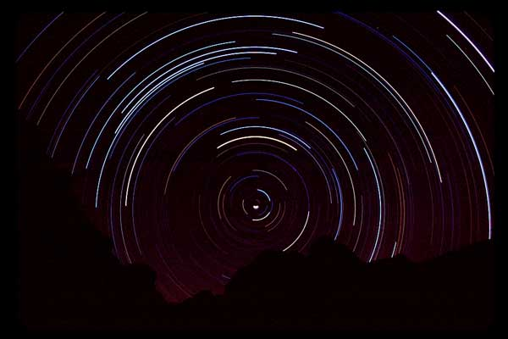
Star tracks, Grand Canyon

